Slide 1
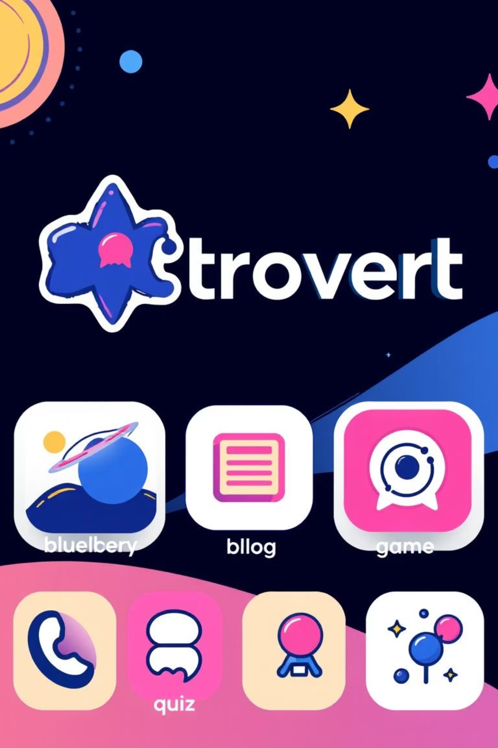
Astrovert: Where Curiosity Meets the Cosmos
Explore the universe like never before with Astrovert, a comprehensive React Native astronomy app designed for discovery, learning, and fun. It's your personal portal to the stars.

Slide 2
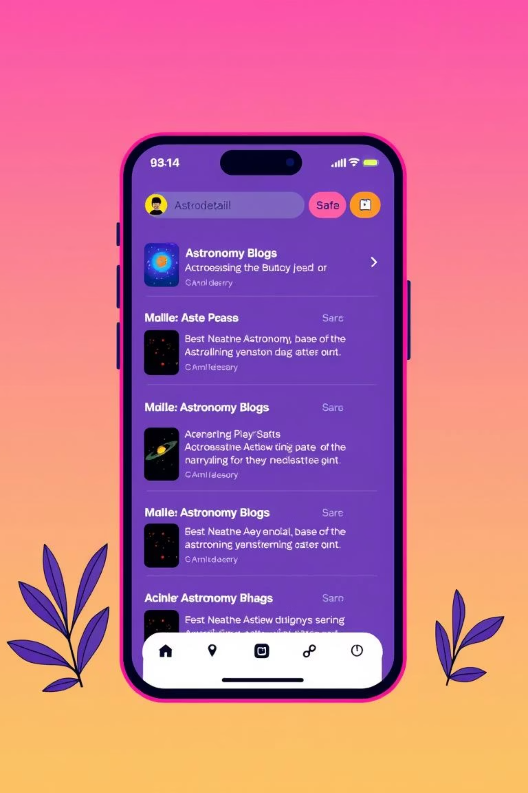
Deep Dive into the Cosmos: The Astronomy Blog
Curated Cosmic Content
Categorized for Easy Discovery
Explore fascinating articles on JWST findings, galaxy formations, and cosmic phenomena. Stay updated with the latest in space science.
Browse content by "Discoveries," "Research," and "Space Exploration" with beautiful card layouts featuring hero images.
Learn On-the-Go
Each article includes educational summaries, perfect for quick learning and understanding complex topics at a glance.

Slide 3
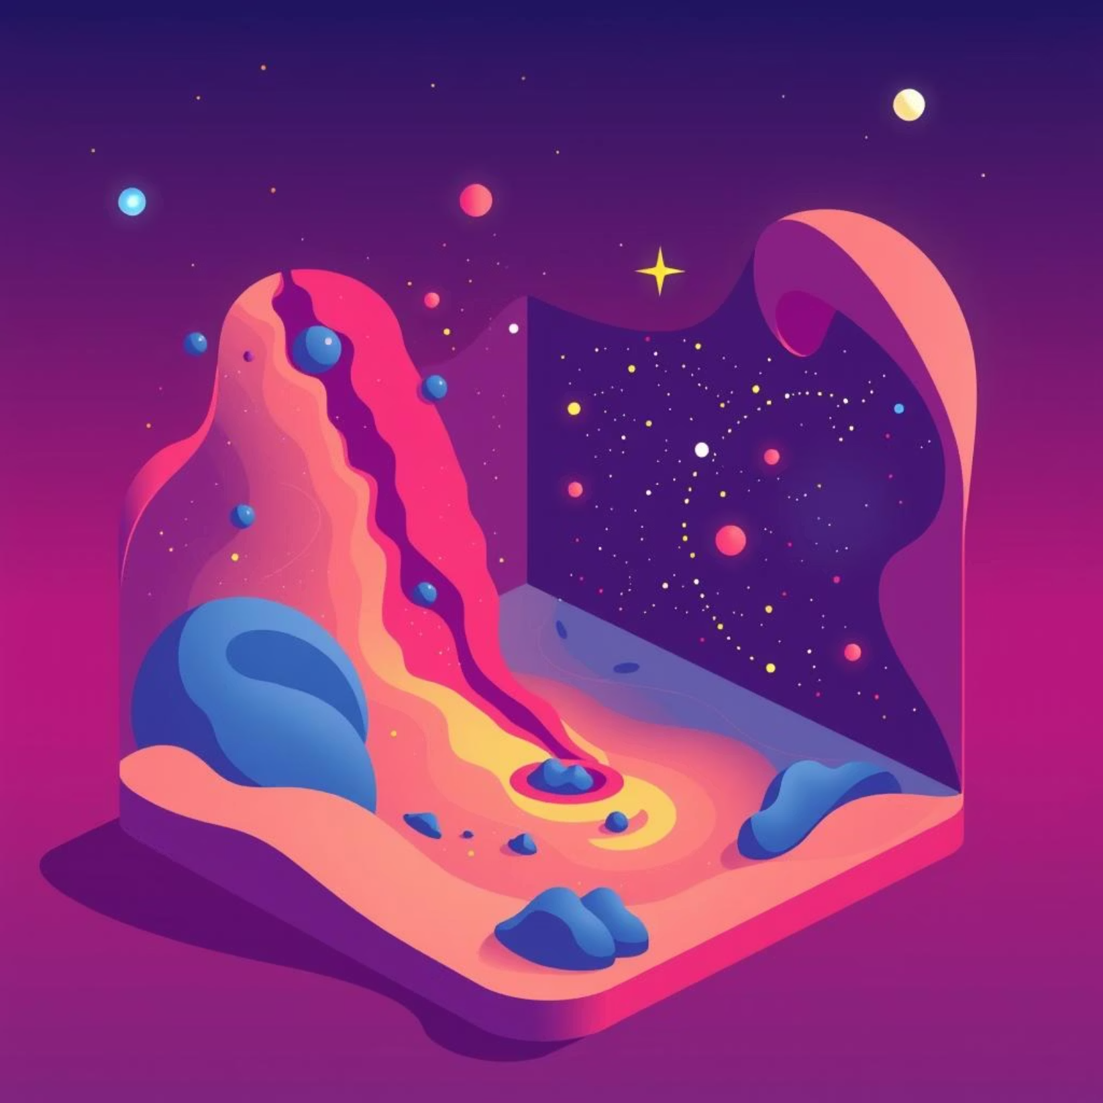
Navigate the Universe: 3D Galaxy Explorer
Real-time Interactive Experience
1
Delve into stunning 3D galaxies built with Three.js, offering fluid rotation, zoom, and pan gestures.
Dynamic Models and Effects
2
Witness vibrant Spiral and Andromeda-type galaxies, enhanced with dynamic particle effects and ambient space audio for full immersion.

Slide 4
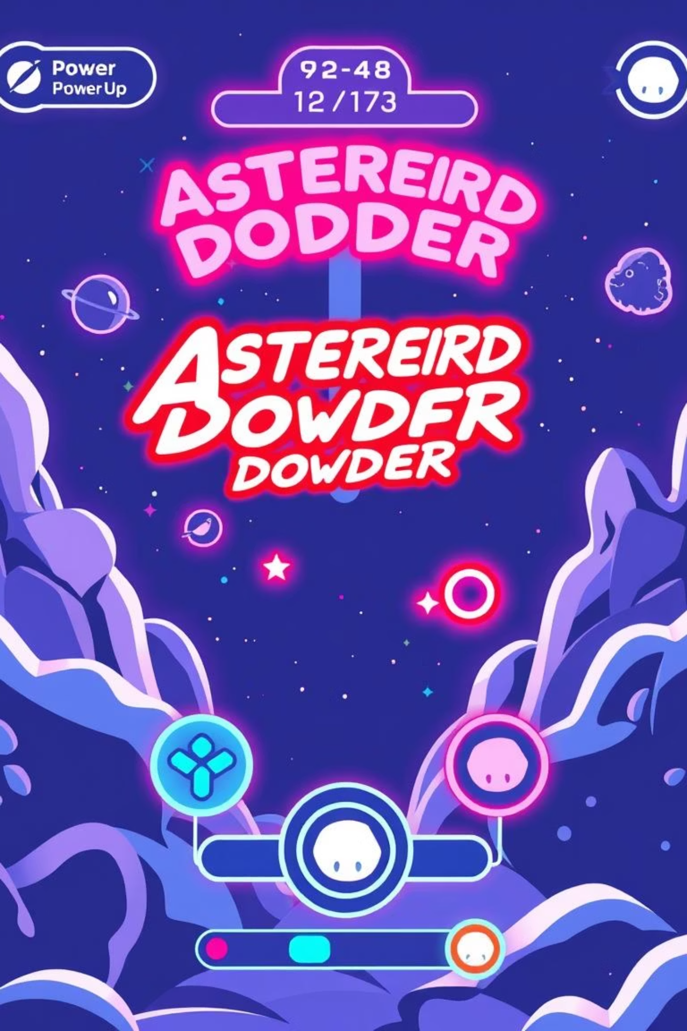






Thrill of the Chase: Asteroid Dodger Game
Arcade Action
Strategic Power-ups
Engage in real-time arcade gameplay with responsive controls and haptic feedback for an immersive experience.
Collect Shields, Speed Boosts, and Score Multipliers to navigate challenging asteroid fields.
Compete and Conquer
Track your high scores on leaderboards and persist through multiple lives and collisions.

Slide 5
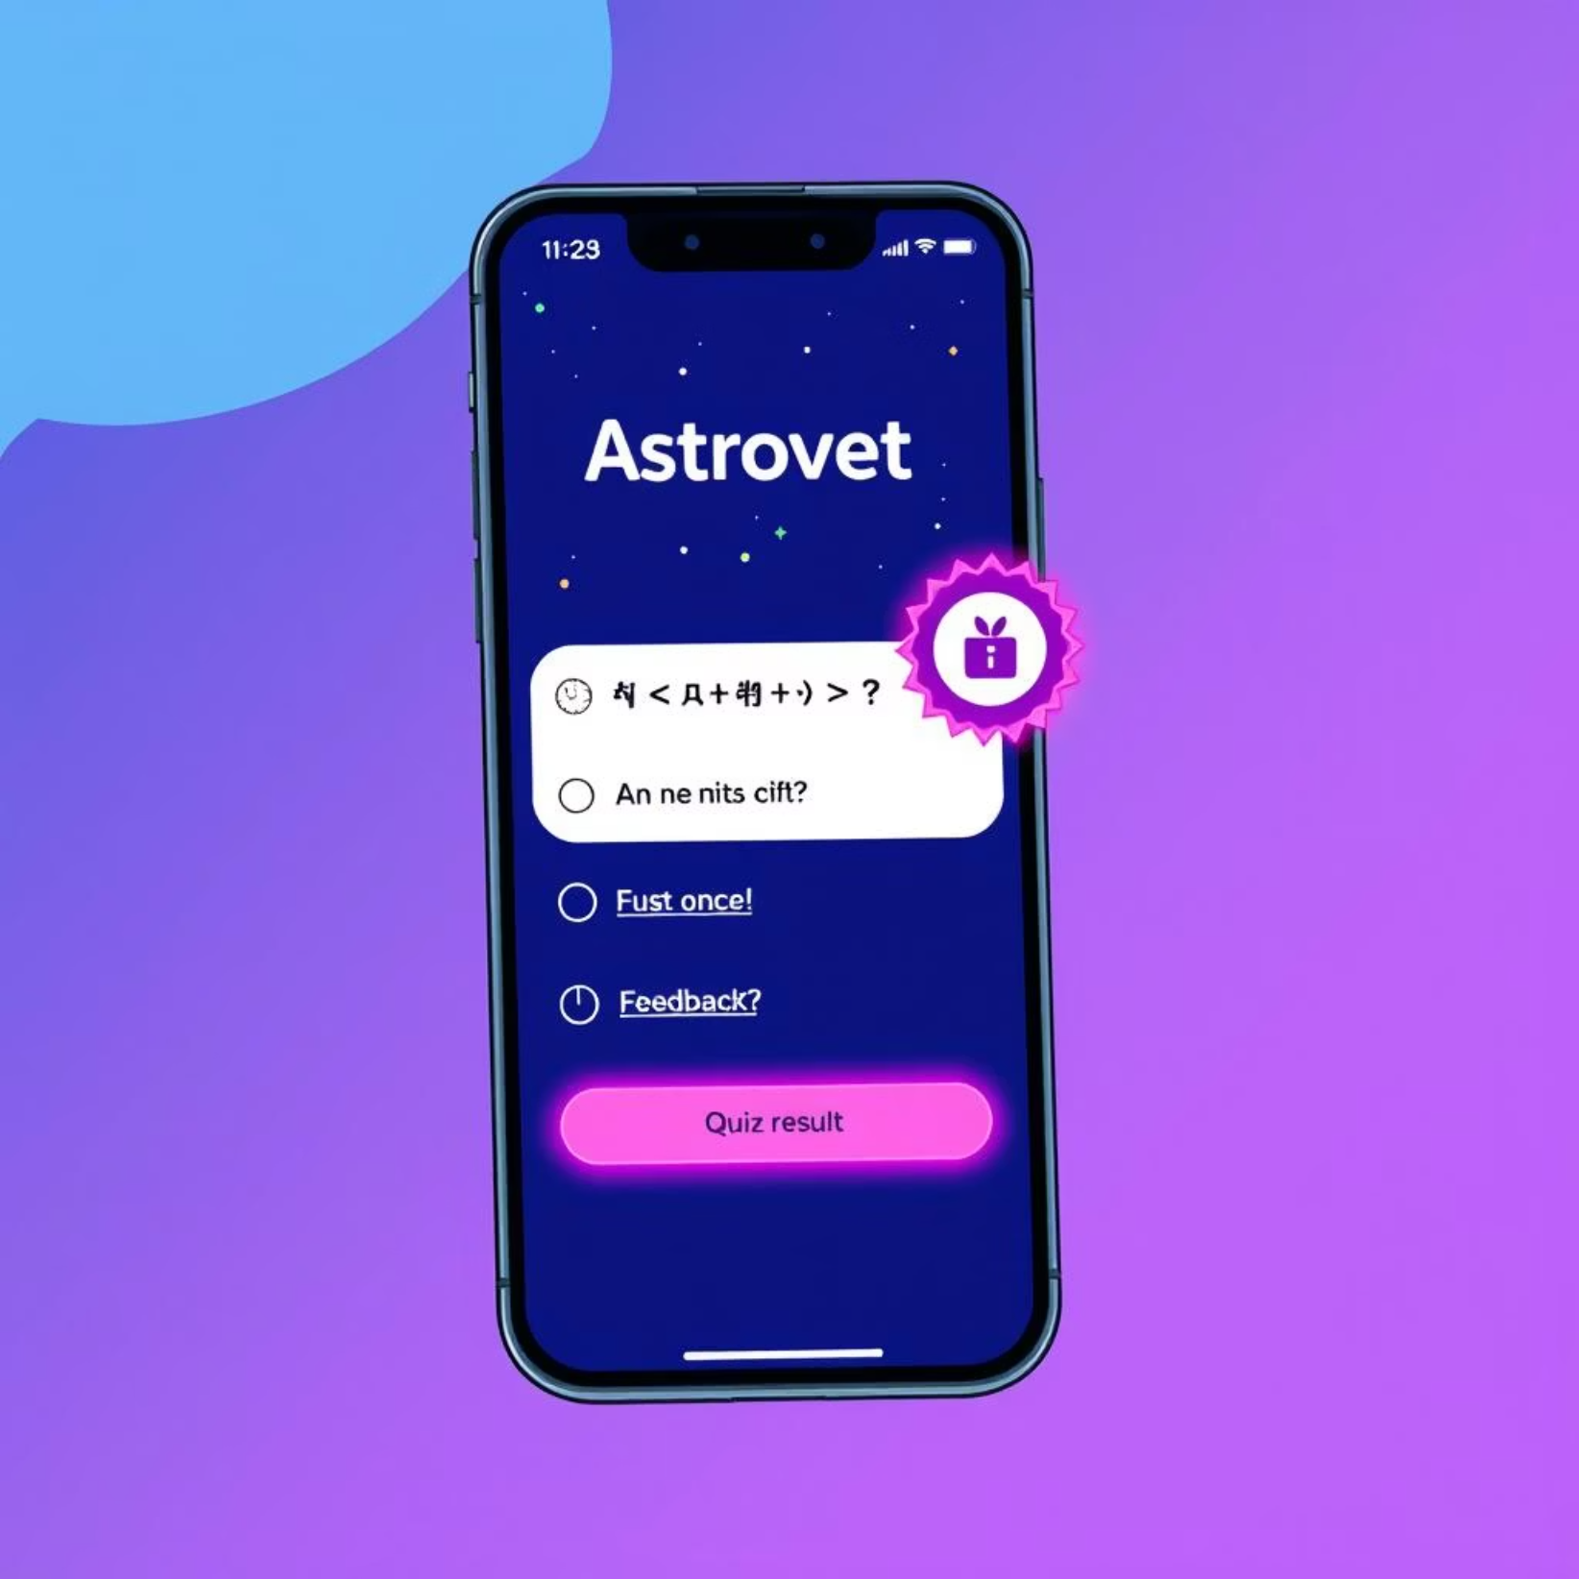
Test Your Knowledge: Quiz Challenge
Challenge yourself with over 50 questions spanning the Solar System, Stars & Galaxies, Space Exploration, and Cosmology.
Timed questions with engaging animations
Instant feedback and explanations after each answer
Track scores, progress, and unlock achievements

Slide 6
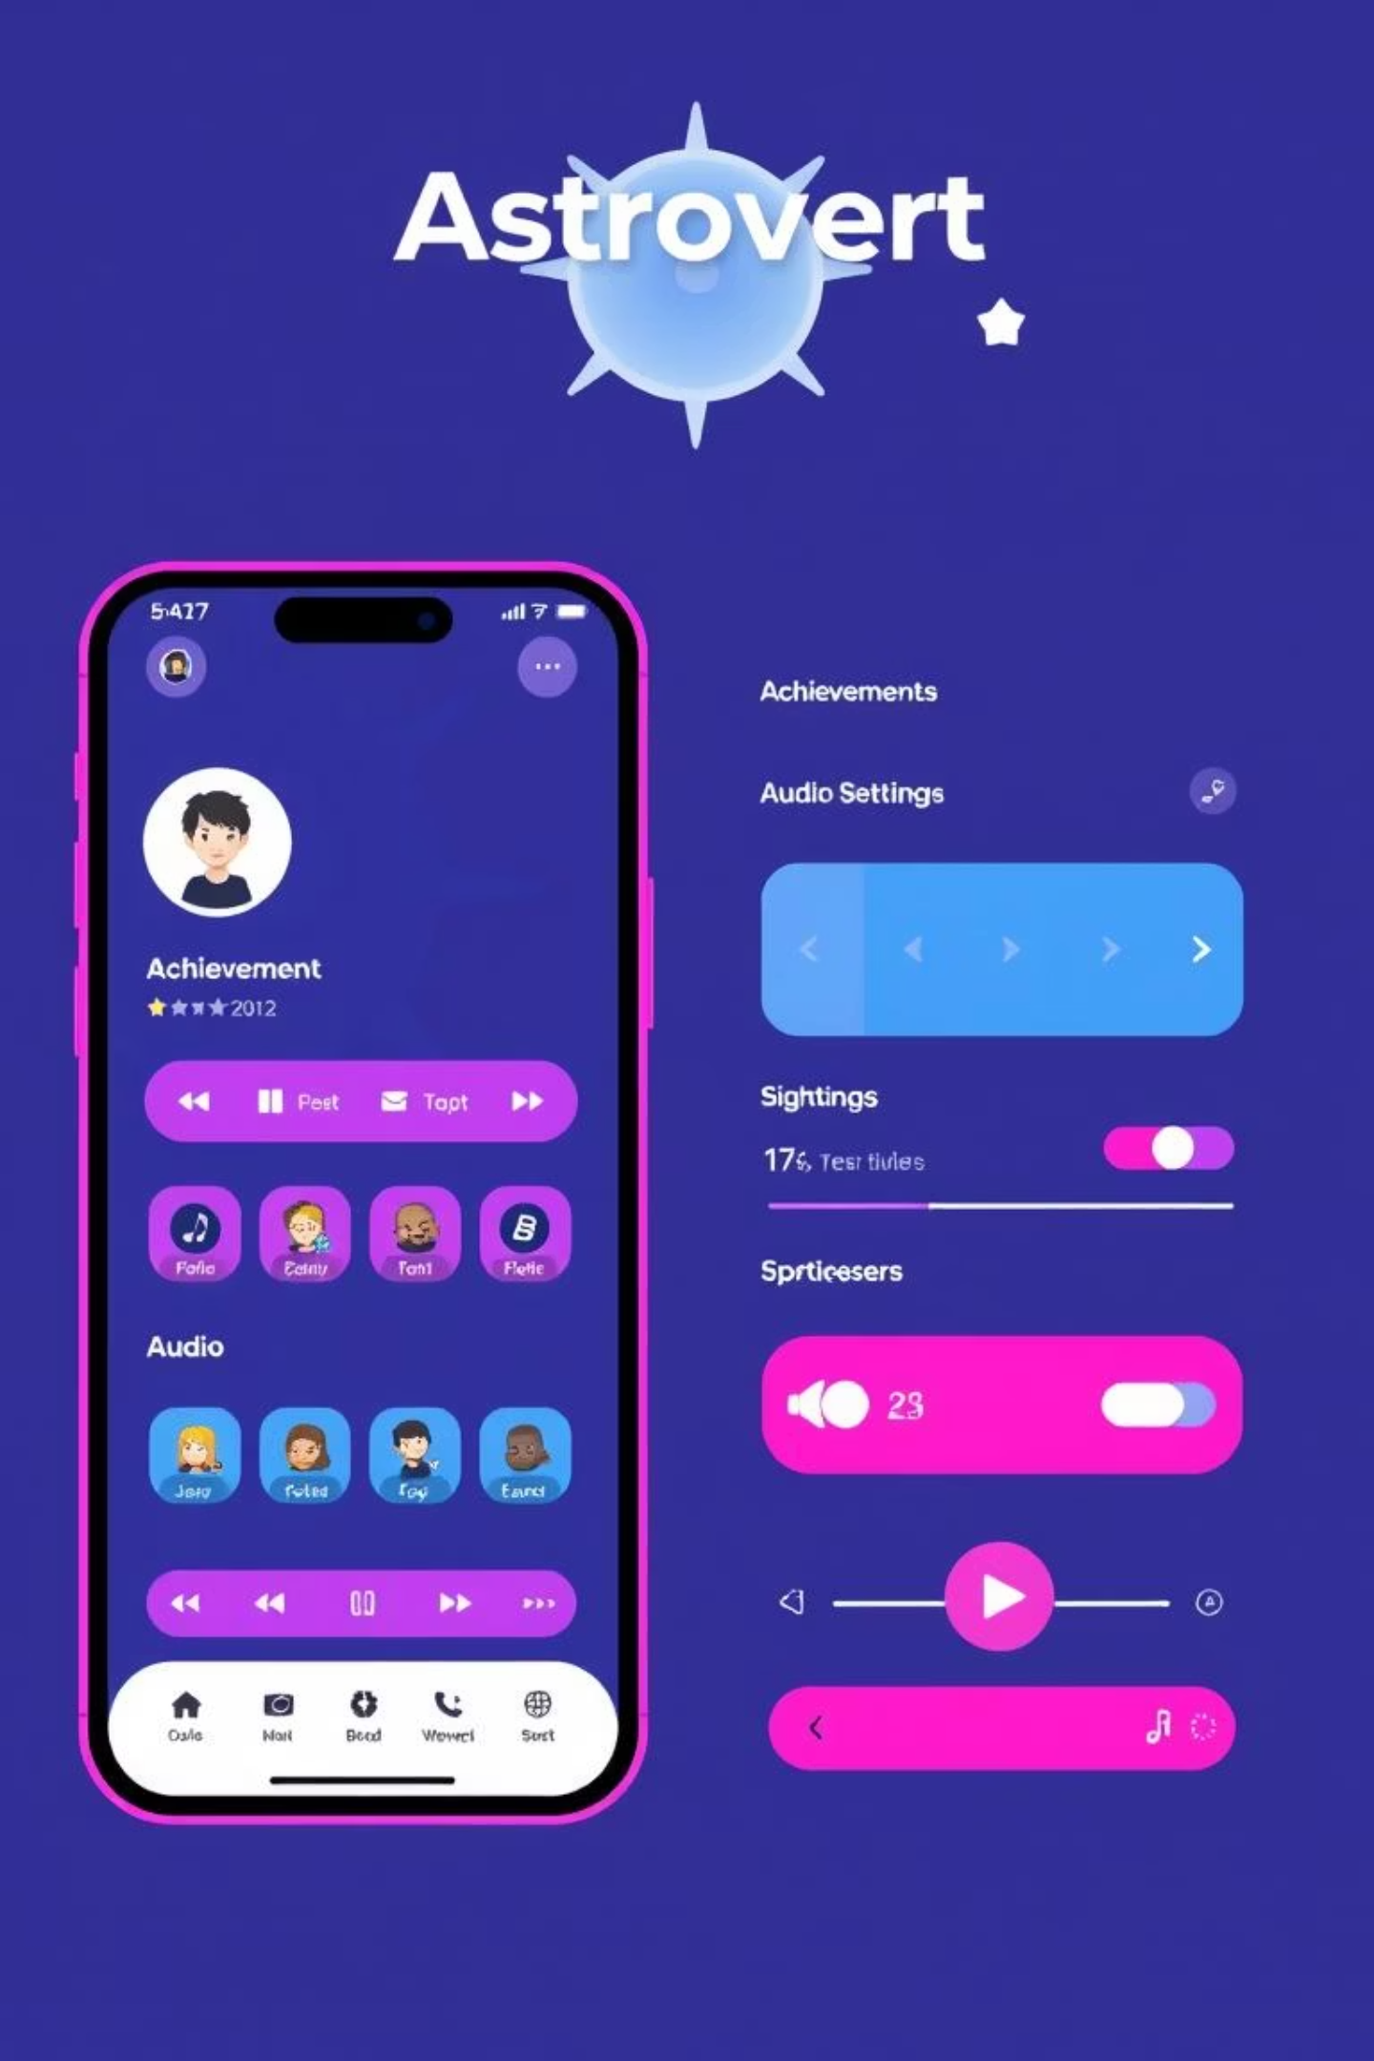




Personalized Experience: Profiles, Audio, and UI/UX
Flexible Account Options
Choose between Guest mode for local progress or Registered accounts for seamless cross-device synchronization.
Unlock Achievements
Earn badges like First Flight, Scholar, Speed Demon, and Universe Commander as you explore and learn.
Immersive Audio
Enjoy ambient soundscapes, sound effects, and fine-tuned volume controls, respecting silent mode settings.
Sleek Cosmic Design
Navigate a cosmic dark theme with elegant gradients, smooth animations, and a focus on accessibility for all users.

Slide 7


The Journey Ahead: Roadmap & Call to Action
Our Technology Stack
What's Next for Astrovert?
Built with a robust foundation for reliability and performance:
Social Features & More 3D Objects
React Native + Expo
TypeScript
Augmented Reality (AR) & Constellation Game
Three.js & React-three/fiber
Real-time News & Voice Tours
React Navigation & AsyncStorage
Multi-language Support
Experience context-based state management, local persistence, and graceful degradation on low-end devices.
Join our community-driven project: Try the APK, share your feedback, and contribute!

